Slide 1
2019

Slide 2
2019
Elektrotel offers, system design, integration and various services for telecommunication industry, defense, industrial solutions and services for the national and international markets. For more than 15 years, we are working to create value for our customers and ourselves
Elektrotel has an organizational structure and a capacity to offer end-to-end solutions, system integration and technology services for service providers and organizations in a wide range of areas from Research & Development, production and maintenance.
Besides being a product design center with a multi-national structure, we can offer services in import and export issues regardless of any business area. We believe that, thanks to our current structure, we will attain our goal to become a world brand in near future. In addition to all these, we are able to offer timely and high-quality service as we also have plastic mold, injection and metal companies within our structure, which all carry us a step further in terms of product integrity.

Slide 3
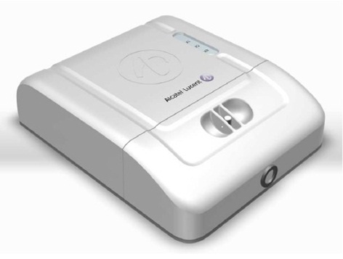
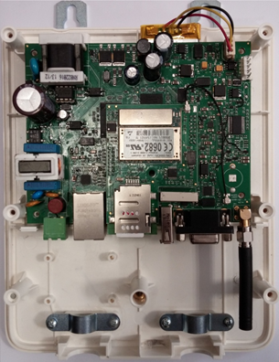
2019
SMART METER READING UNIT

Slide 4
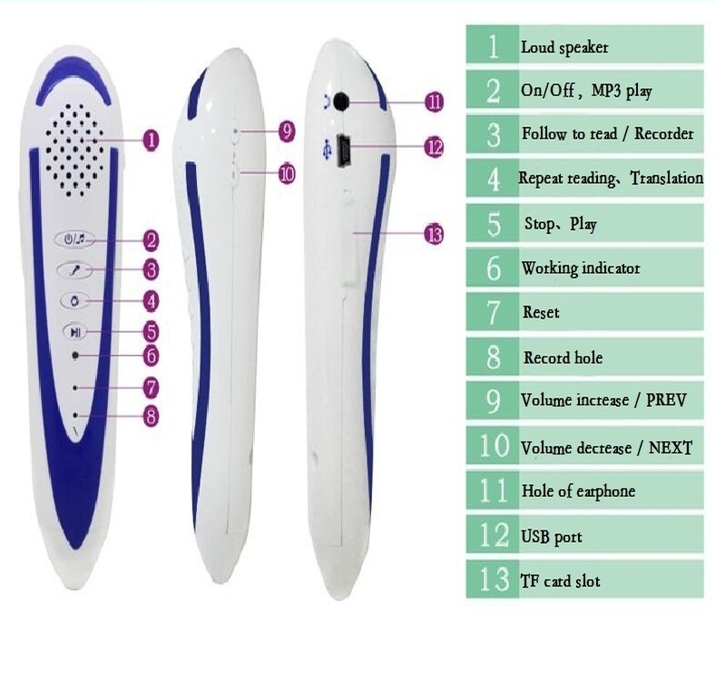
2019
READING PEN FOR VISUALLY IMPAIRED PEOPLE
Remarking and reading
Voice recording and play
Reminder function
Multi language
Answers check and change it if needed
Exam start end duration change
QR code reading
Start time and question reading time recording.
Txt files security facility
Reading speed change
Empty questions reminder
Pause facility
600MAH Li-on battery can supply 8 hours working time
8GB memory
Internal speaker and output for headphones

Slide 5
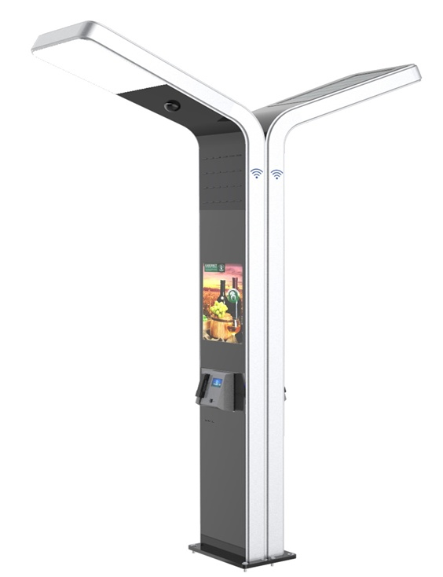
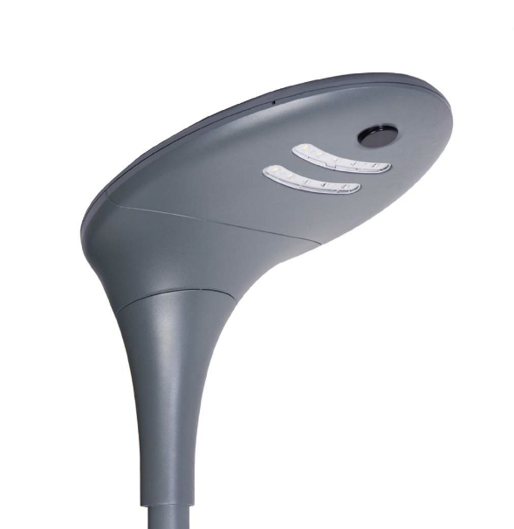
2019
SOLAR STREET LIGHTS
- Solar + Mains.
- Management system facility.
- Variable components and internal structure
- Informative
- %100 solar energy.
- Elegant design for streets and gardens.

Slide 6
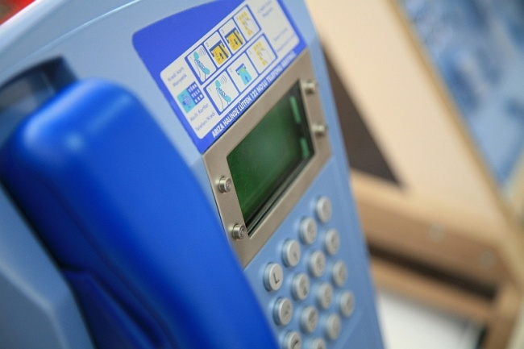
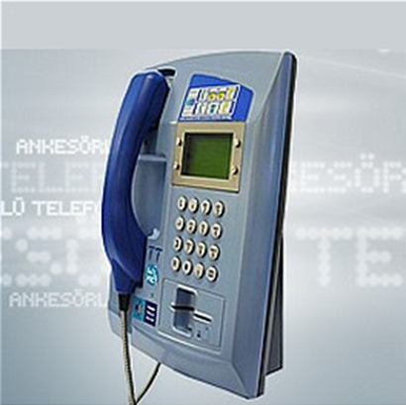
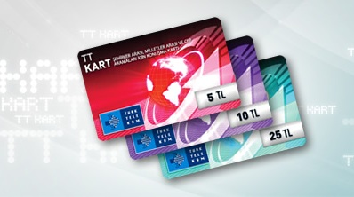
2019
TURKISH TELECOM – PAYPHONE SYSTEMS
Payphone systems that works with Smart cart and credit card. This system also can be used as internet accesspoint and it has SMS capability.

Slide 7
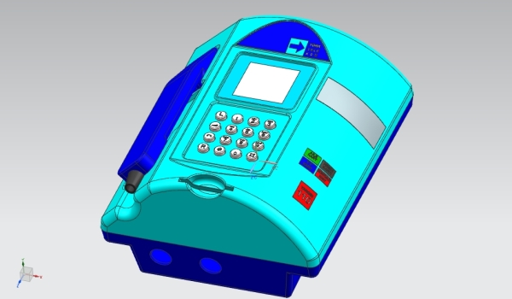
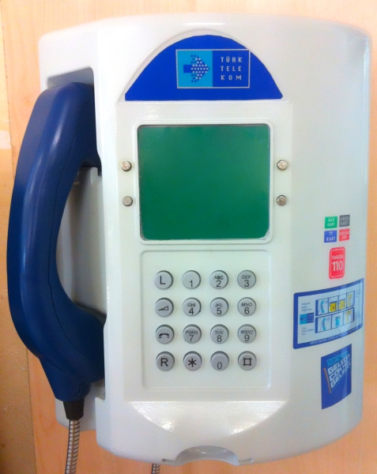
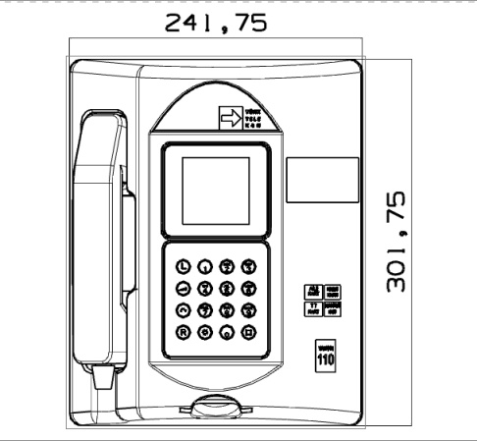
2019
NEW GENERATION PAYPHONE SYSTEM THAT DESIGNED FOR TURKISH TELECOM
This is our new payphone system that developing for Turk Telekom. This system have more capability in terms of memory and reliability and easier to operate. Also now it has ability for commercials on the big display.

Slide 8
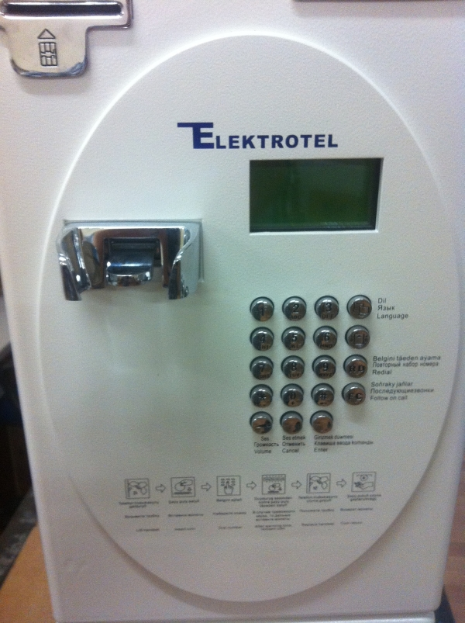
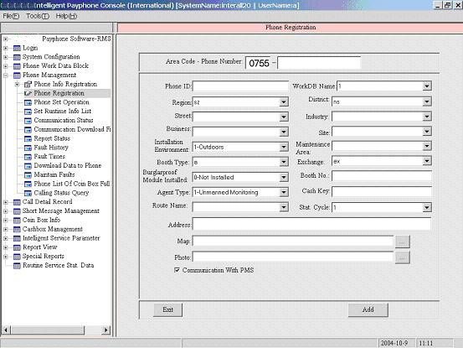
2019
TURKMENISTAN COINPHONE SYSTEM
This system has been developed for Turkmenistan. It can work with coin and smartcard also.

Slide 9
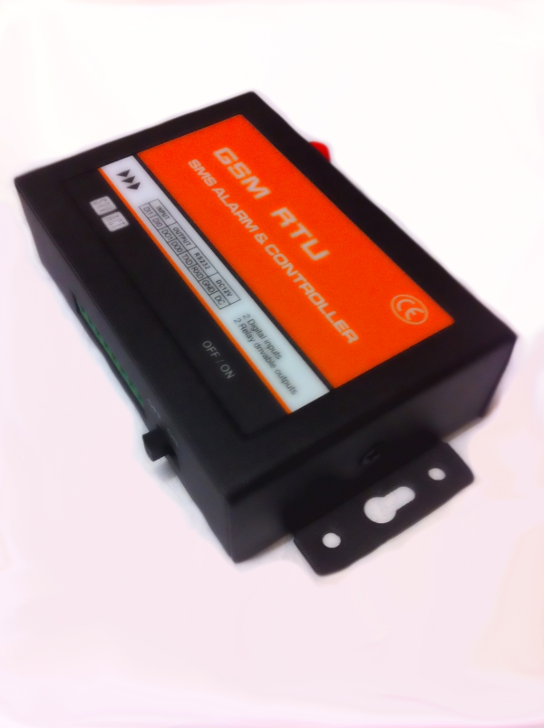
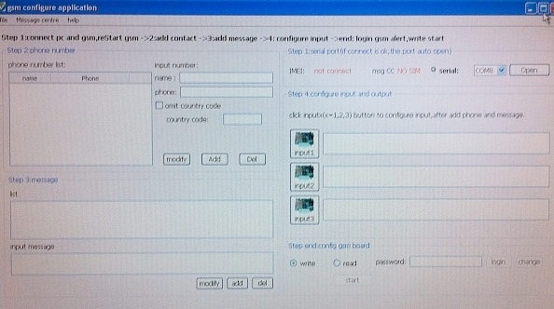
2019
GSM SMS alarm system
Three channel Smart GSM SMS Alarm security system for home and offices to tracing remotely.

Slide 10
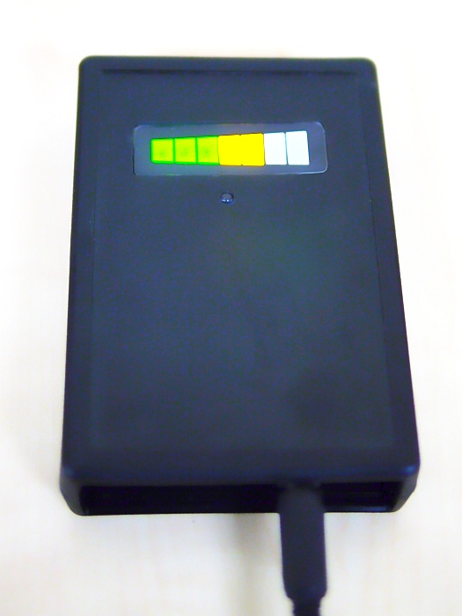
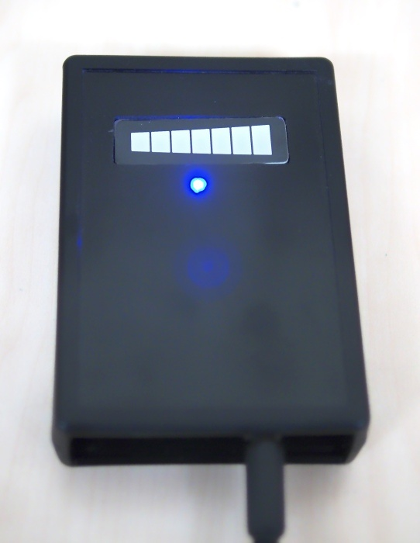
2019
AIR QUALITY MONITORING
It can be used in home, offices, hospitals, cinema, pub etc. This device can read air pollution continuously and displays continuously on LED bar. If air quality drops to critical level for living, LED bar will be displayed RED level and sound will be heard. Also device gives a relay output if display is RED

Slide 11
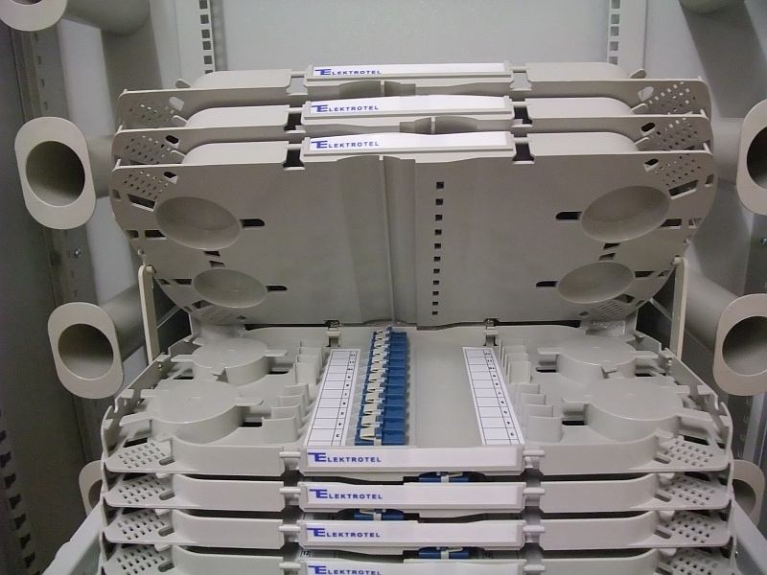
2019
FIBER OPTIC TRAYS THAT APPROVED FROM TT

Slide 12
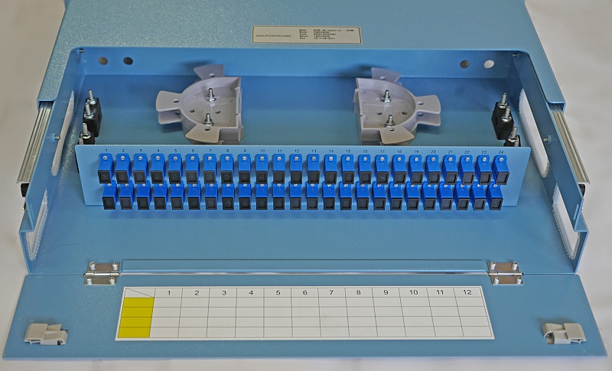
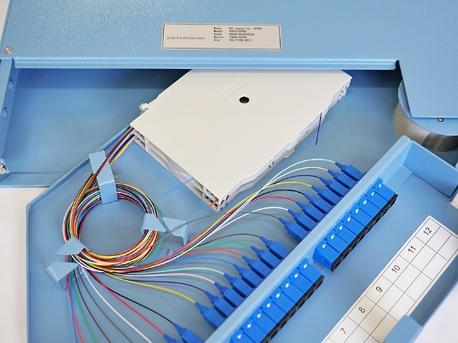
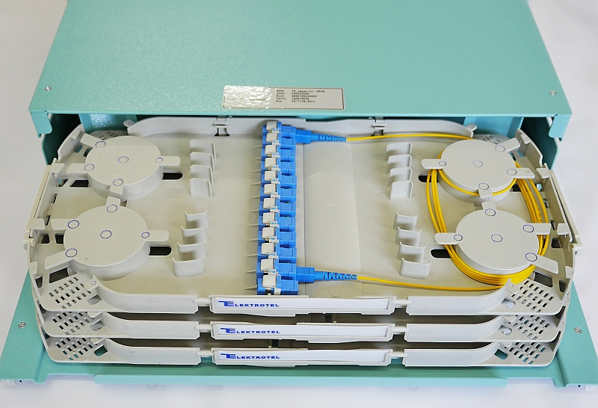
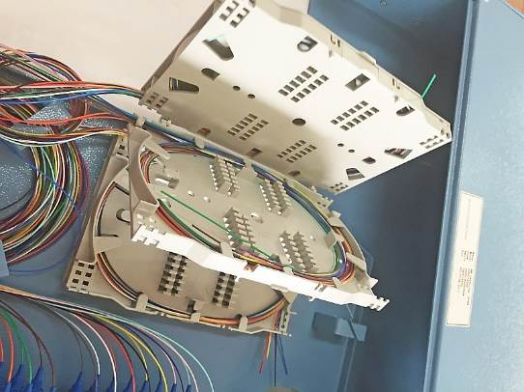
2019
NEW GENERATION FIBER OPTIC DRAWERS

Slide 13
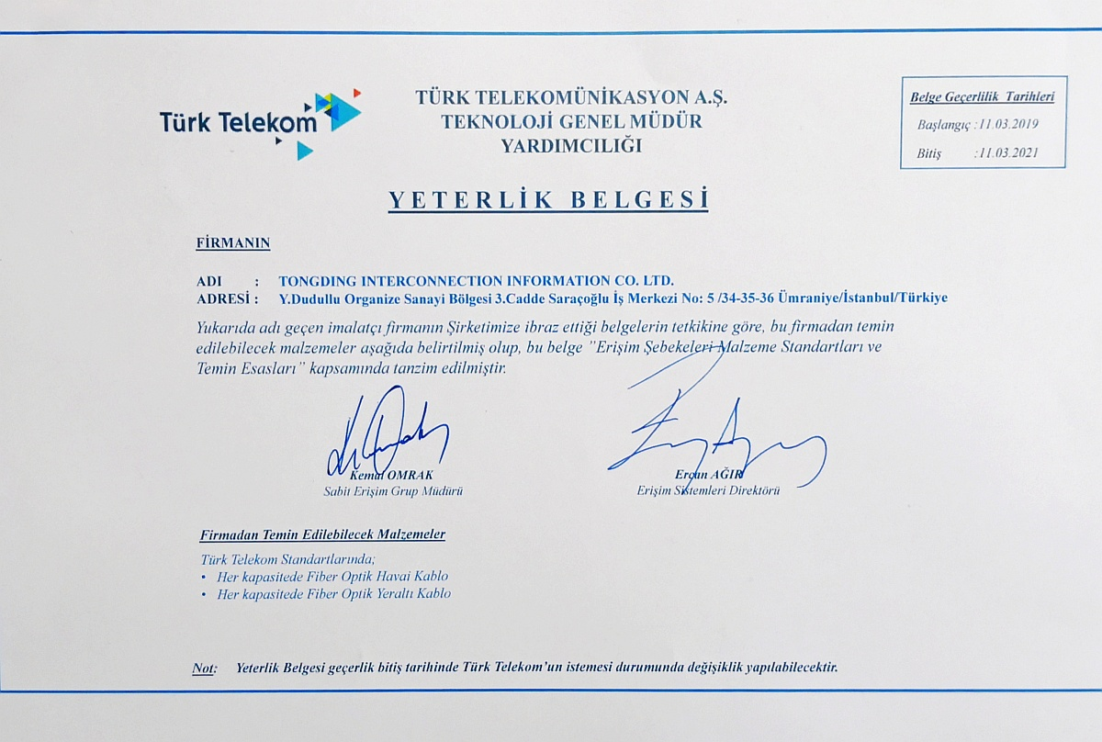
2019
FIBER OPTIC CABLE PARTNERSHIP AND APPROVAL FROM TT

Slide 14
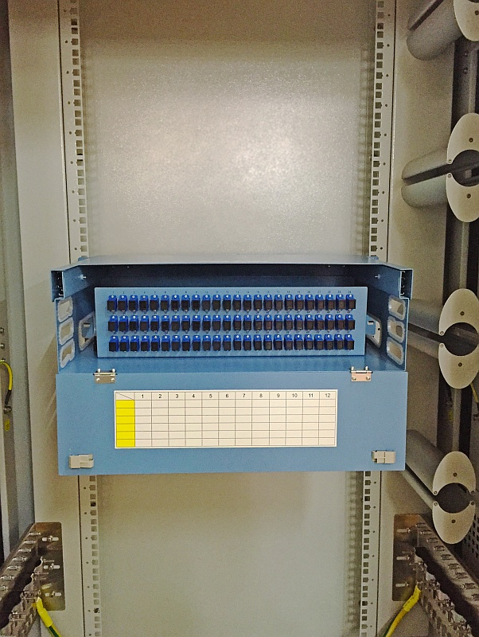
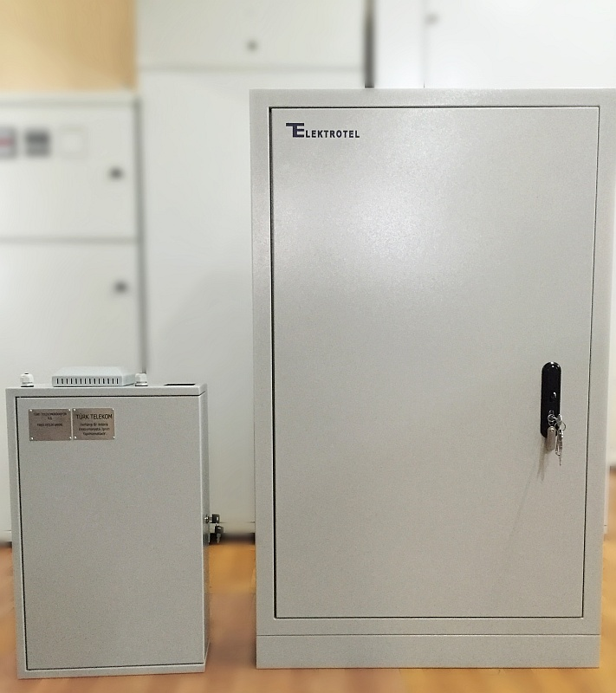
2019
FIBER CABINETS

Slide 15
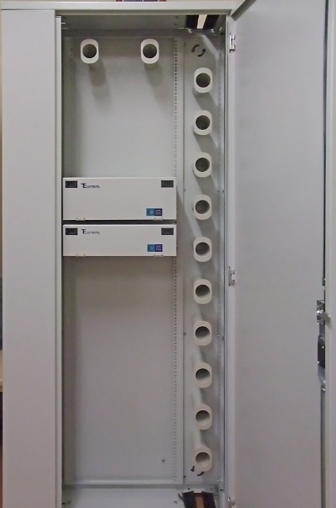
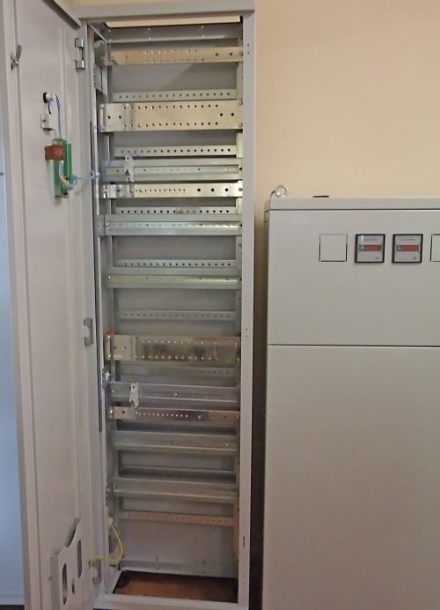
2019
FIBER CABINETS

Slide 16
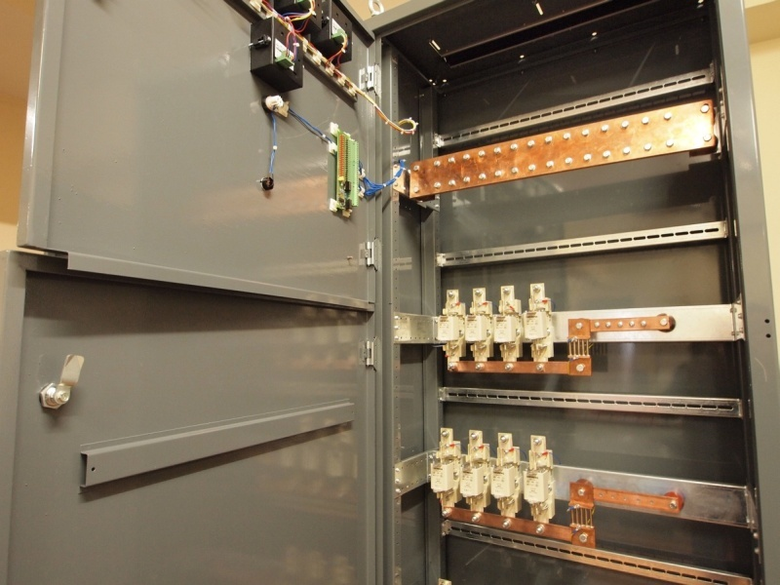
2019
POWER DISTRIBUTION CABINET FOR TELECOM SYSTEMS

Slide 17
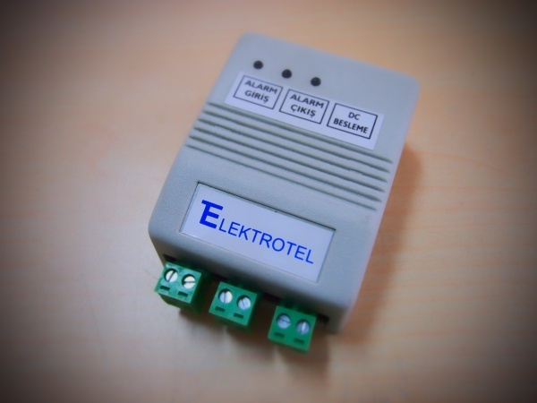
2019
TURKCELL GATE TRACING AND ALARM UNIT

Slide 18
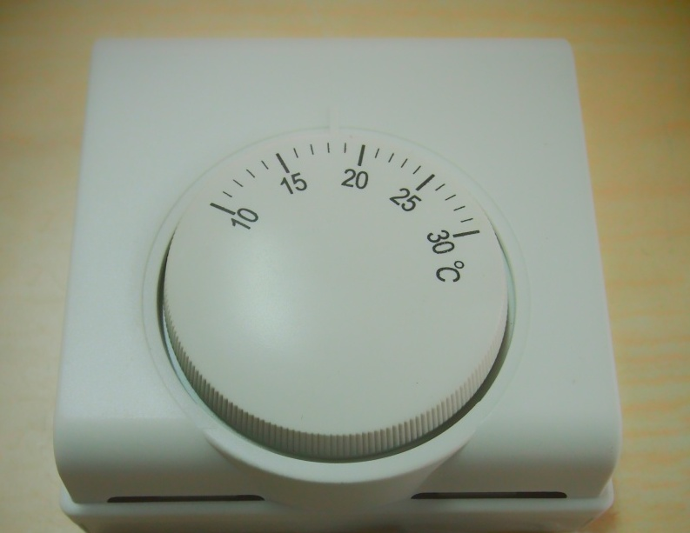
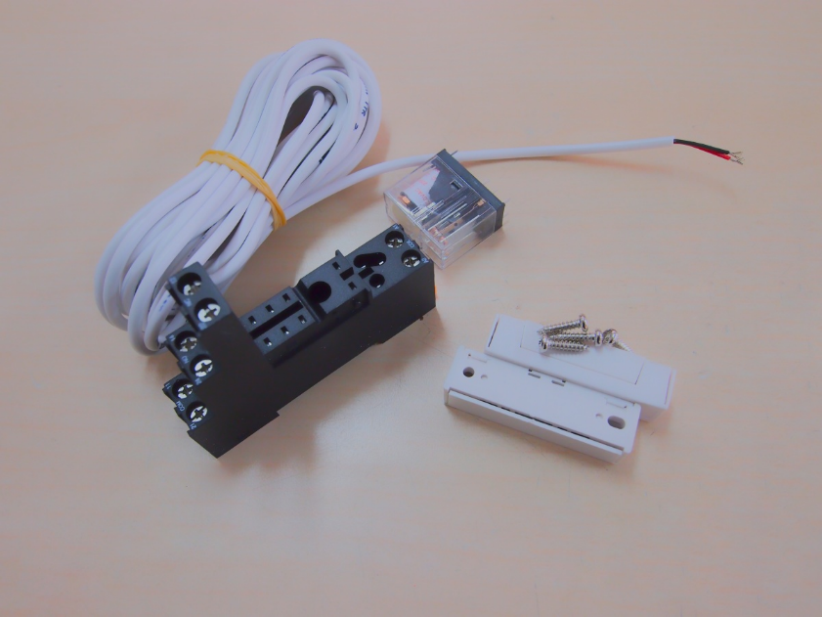
2019
TURKCELL HEAT SENSOR EQUIPMENTS

Slide 19
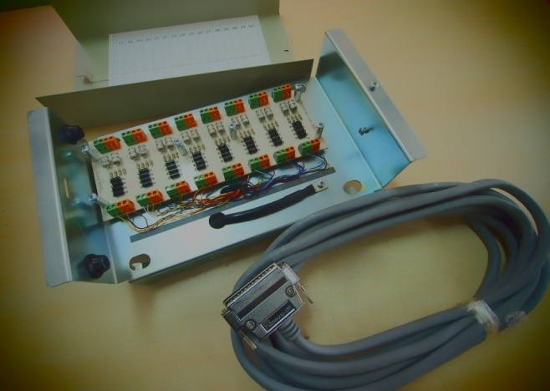
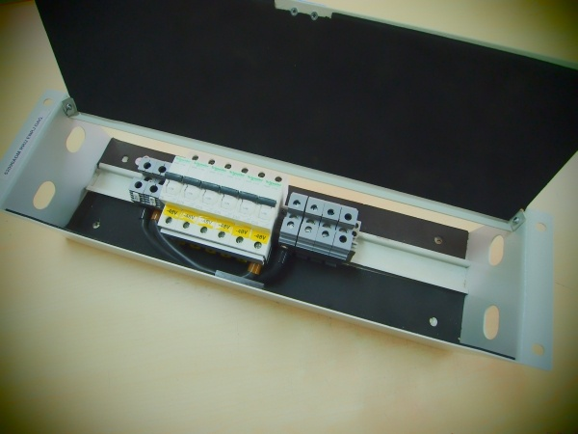
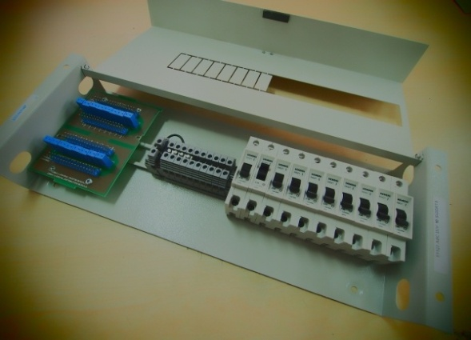
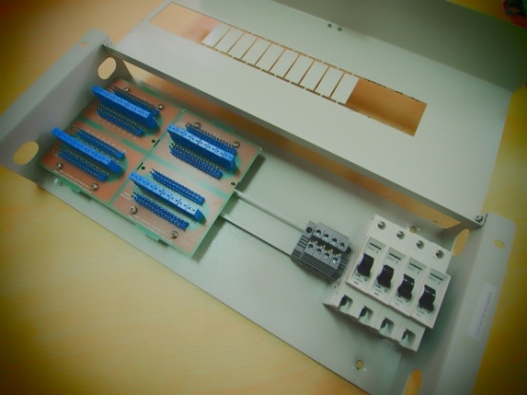
2019
ENERGY AND DATA PROTECTION BOXES FOR GSM PROVIDERS

Slide 20
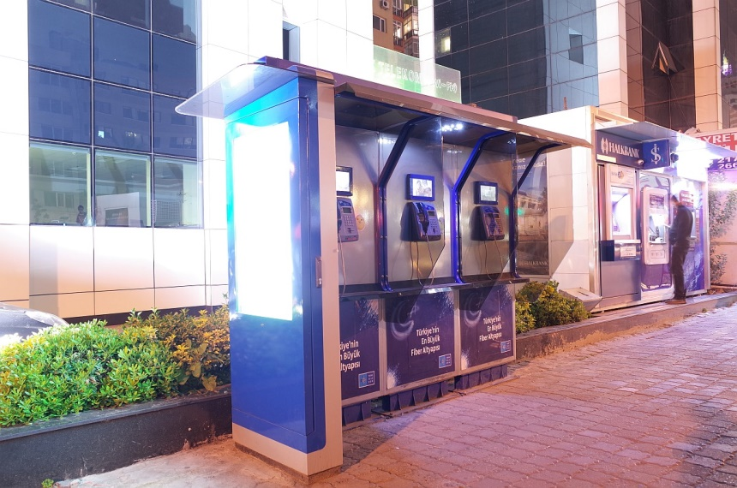
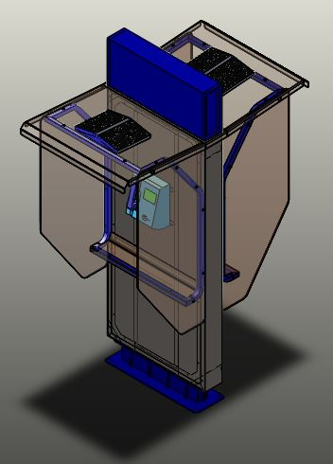
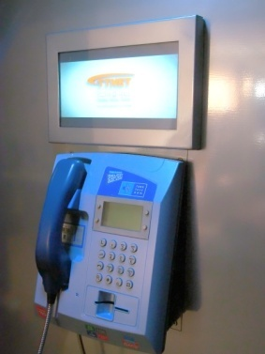
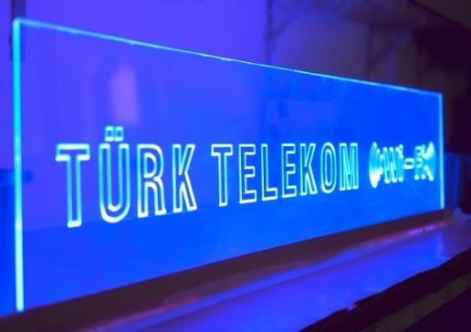
2019
SMART TELEPHONE BOOTS
Solar energy / LED lights
Remote manageable commercial screens
Multimedya hardware
Outdoor components
Easy to setup and maintenance

Slide 21
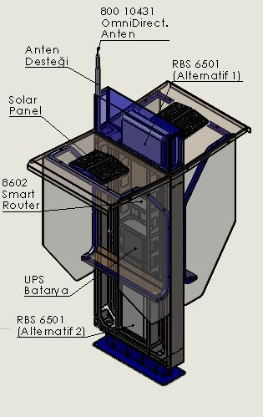
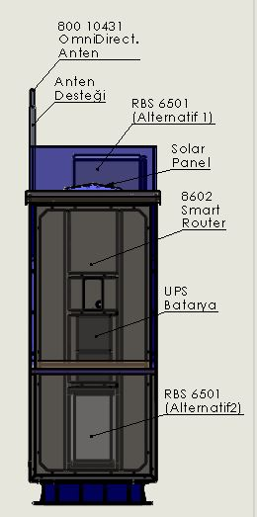
2019
TWIN BOOT / RBS 6501
Sample configuration:
RBS 6501 – Small BTS
800 10431 Omnidirectional Antenna
8602 Smart Router
BCI 22NF - UPS Battery
Mains :
Various inputs
Solar energy support
Modular, easy setup and maintenance
Solar power / LED lights
Multimedia & commercials with management
Remote management commercial panels / Easy to integrate
Strong design against vandalism and outdoor features

Slide 22
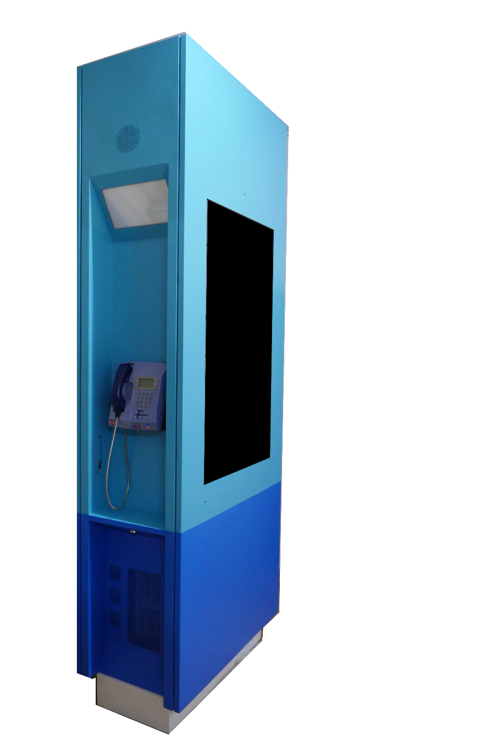
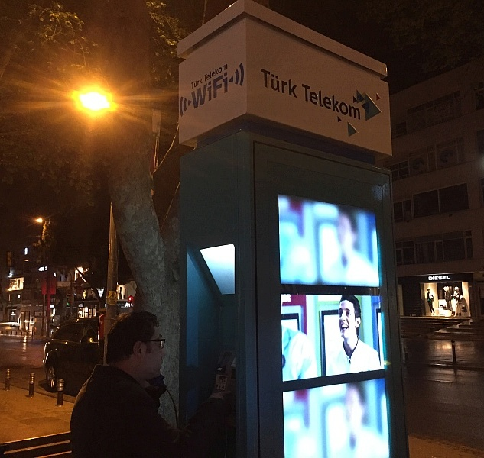
2019
MULTIFUNCTIONAL SMALLCELL INFORMATION POINT
2 X 55 inch big screen
Payphone
SmallCell
Airconditioner
Camera recording
Remote management
UPS
Bluetooth
17 inch touchpad

Slide 23
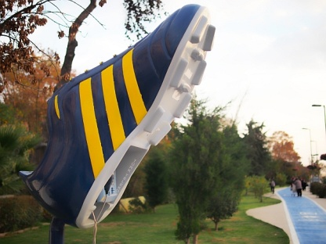
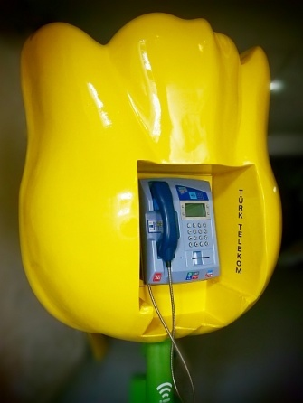
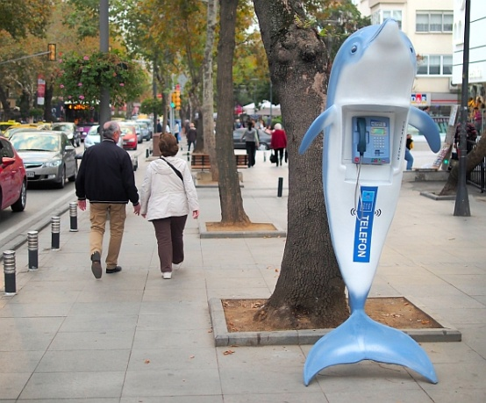
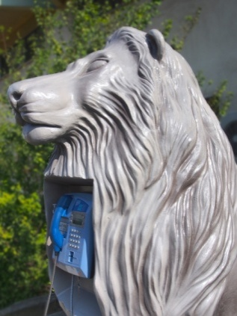
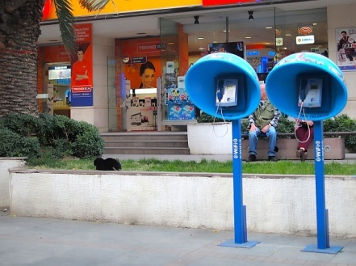
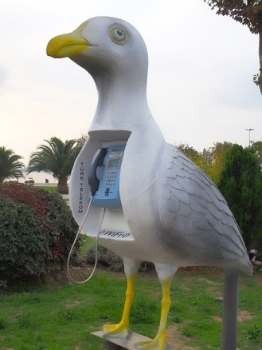
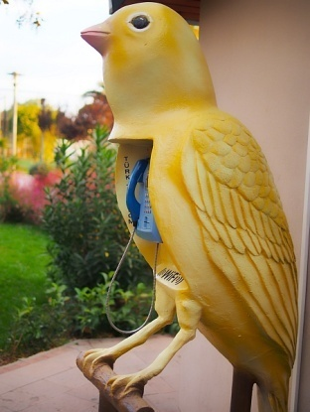
2019
FIGURE BOOTS FOR PAYPHONES

Slide 24
2019
REFERANSLARIMIZ

Slide 25
2019
OUR CHINA COMPANIES

Slide 26
2019
OUR PLASTIC INJECTION AND MOLD COMPANY
Plameta company produces high quality ve very detailed plastic materials and moulds for many well known companies in Turkey. Our company produces plastic parts and moulds for especially telecommunication, otomotive, white goods industries…

Slide 27
2019
ELEKTROTEL ELEKTRONİK VE TELEKOMÜNİKASYON SAN. VE TİC. LTD. ŞTİ. Adres: Yukarı Dudullu Organize Sanayi Bölgesi 3. Cadde Saraçoğlu İş Merkezi 5/34-35-36 Ümraniye İstanbul TÜRKİYE Tel: +90 216 420 90 92 (Pbx) Fax: +90 216 420 90 48 E-posta: info@elektrotel.com
WWW.ELEKTROTEL.COM

Slide 28
2019
Thank you
www.elektrotel.com

